Slide 1

13th International Conference on Computer and Knowledge Engineering
(ICCKE2023)

Slide 2
Theophilus Ebuka Odoh
African Vultures Optimization Algorithm for Optimal Damping Controllers Design in the Electrical Power Grid System

Slide 3
OUTLINE OF THE PRESENTATION
Introduction
Problem statement
Aim and Objectives
Literature review
Research gap
Methodology
Results
Contribution to knowledge
Conclusion
Recommendations
References

Slide 4
INTRODUCTION
Power system oscillation is a major challenge to the stability of the power system.
Damping controllers such as power system stabilizer (PSS) is designed and applied to the power system to control power system oscillation by improving damping of Electromechanical modes (Ems)
Optimal PSS design requires optimization algorithm

Slide 5
Problem Statement
Power System Oscillation is a major threat to the safe operation of the power grid system
The design of Automated damping controllers like the PSS damping controller is very important
To model an optimal PSS damping controller, an optimization algorithm is needed.

Slide 6
Aim and Objectives
The aim of this research, was to design a damping controller using African vulture optimization algorithm (AVOA) in power system.
The research aim was achieved through the following objectives
To model the power test systems (SMIB, WSCC and New England) in MATLAB/SIMULINK environment.
To model a damping controller for the above test system using African vulture optimization algorithm ( AVOA)
To validate the proposed damping controller design by comparing its performance with genetic algorithm (GA) and particle swarm optimization (PSO).

Slide 7
Literature review
Title and Reference | Methodology | Result | Research gap
Implementing the Henry gas solubility optimization algorithm for optimal power system stabilizer Design [1] | The Heffron-phillips model of SMIB was used, PSS damping controller using Henry gas solubility algorithm was designed | The Henry gas solubility algorithm based PSS performed better than atom search algorithm PSS and no controller conditions | The PSS controller was applied on SMIB test system only
Parameter optimization of power system stabilizers via the kidney-inspired algorithm [2] | PSS damping controller for low frequency oscillation damping in a SMIB system | Kidney inspired based PSS performed better than particle swarm and bat algorithm based PSS | The PSS controller was applied on SMIB test system only
General relativity search algorithm: a global optimization approach [3] | GRSA was developed and tested on PSS controller design in WSCC system | GRSA-PSS performed better than GA and PSO based PSS damping controllers | The PSS controller was applied on WSCC test system only
Artificial Gorilla Troops Optimizer for Optimum Tuning of TID Based Power System Stabilizer[4] | TID based PSS was designed using Artificial Gorilla Troops Optimizer in SMIB system | The combined controller performed better than PSS or TID controller only | The TID-PSS controller was applied on SMIB test system only
Cuckoo search optimization algorithm for designing of a multimachine power system Stabilizer [5] | Adopting the cuckoo search optimization, PSS controllers were designed in a multi-machine power system | Cuckoo search optimization algorithm outperformed GA, PSO, and Harmony search optimization | The PSS controller was applied on SMIB test system only

Slide 8
Research Gap
From the literatures reviewed, this research filled in the gap by:
Introducing a new optimization algorithm named African vulture’s optimization algorithm to optimally design a power system stabilizer in SMIB, WSCC and New England Power test systems.

Slide 9
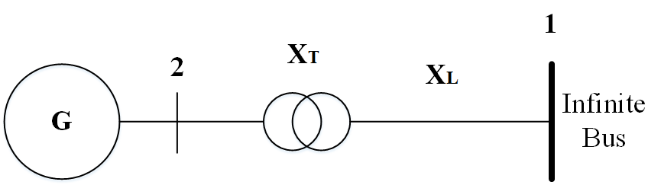
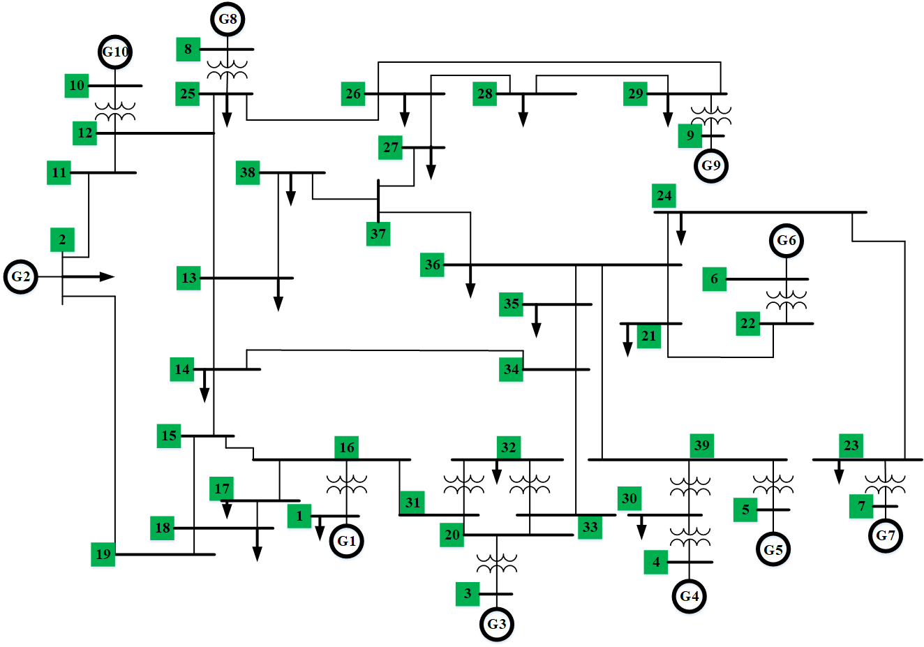
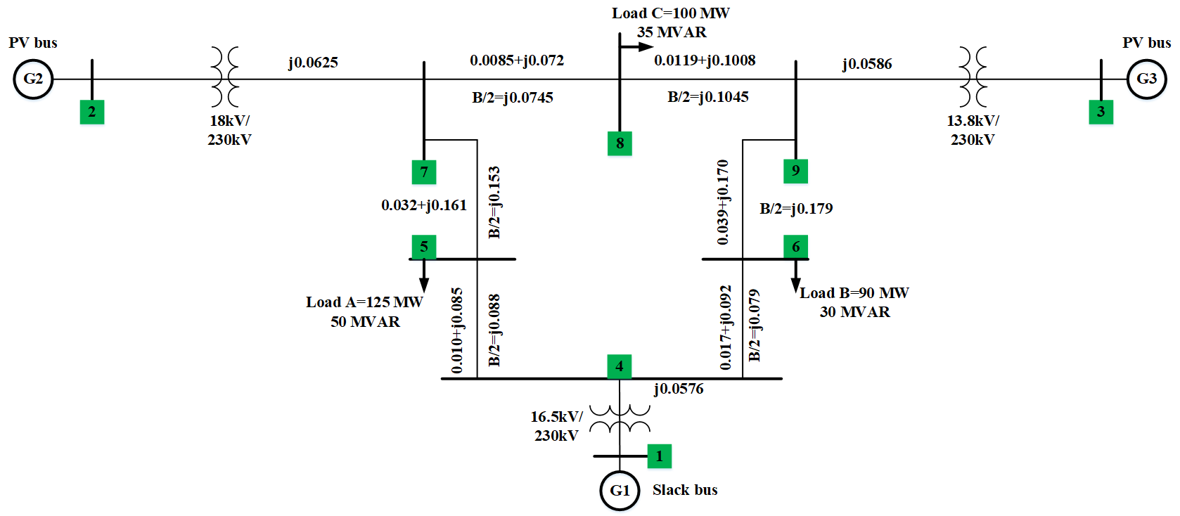
Methodology
Single line diagram of SMIB
Single line diagram of New England
Single line diagram of WSCC

Slide 10
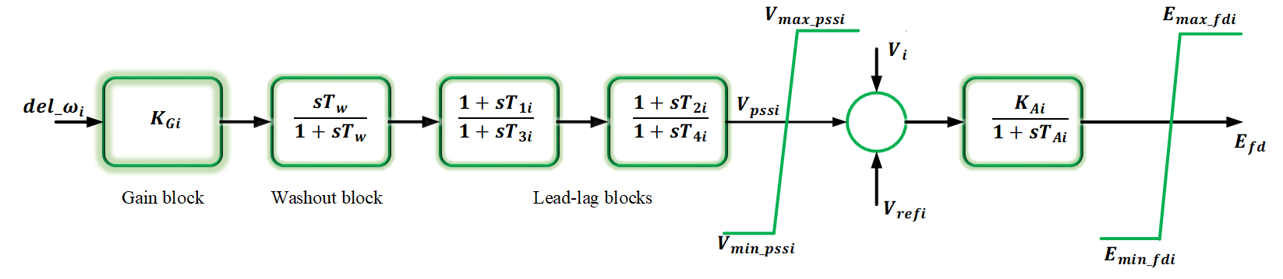
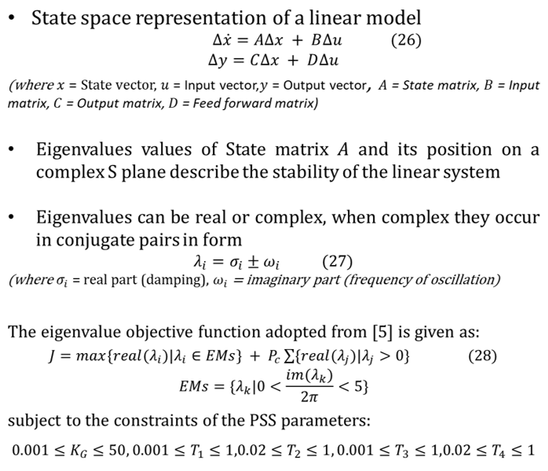
PSS Damping controller model design
PSS damping controller model
Complex S-plane

Slide 11
AVOA
AVOA is a meta-heuristic algorithm which mimics the African vultures behaviour
The AVOA also demonstrates exploration and exploitation ability in its algorithm
This research implements the AVOA in PSS damping controller design
Flow chart of the AVOA Process

Slide 12
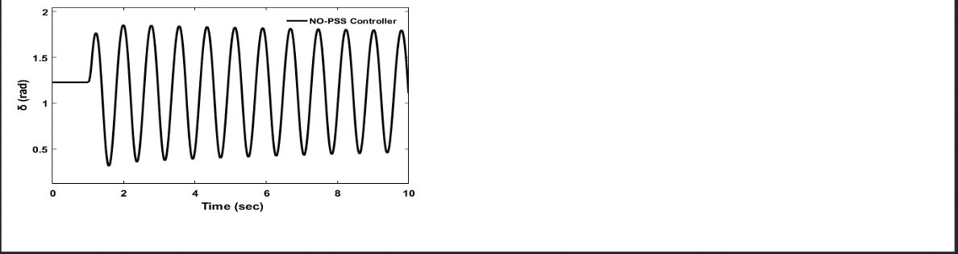
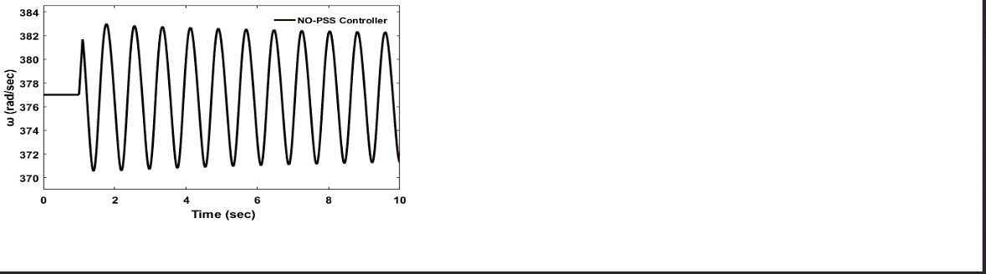
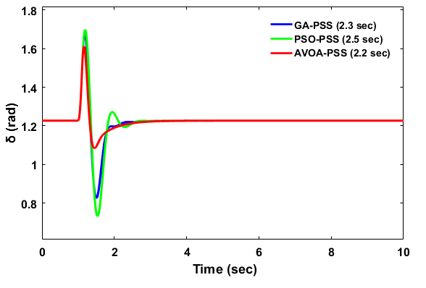
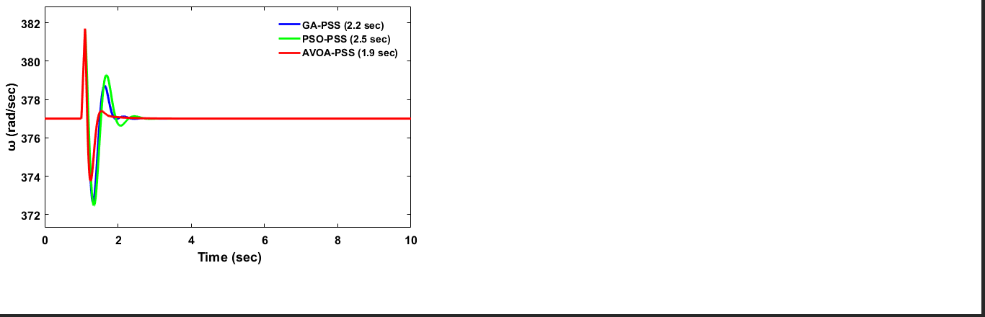
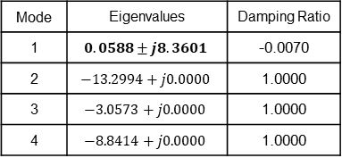
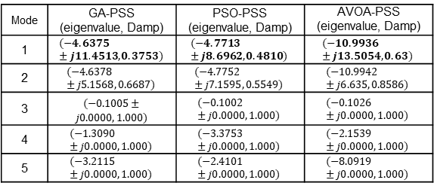
Results
SMIB
Rotor speed and angle deviation
PSS damping controller design rotor speed and rotor angle response
State matrix eigenvalues and damping ratio
Mode | GA-PSS (eigenvalue, Damp) | PSO-PSS (eigenvalue, Damp) | AVOA-PSS (eigenvalue, Damp)
1 | $$(−4.6375±j11.4513, 0.3753)$$ | $$(−4.7713±j8.6962, 0.4810)$$ | $$(−10.9936±j13.5054, 0.63)$$
2 | $$(−4.6378±j5.1568, 0.6687)$$ | $$(−4.7752±j7.1595, 0.5549)$$ | $$(−10.9942±j6.635, 0.8586)$$
3 | ­$(−0.1005±j0.0000, 1.000)$ | $$(−0.1002±j0.0000, 1.000)$$ | $$(−0.1026±j0.0000, 1.000)$$
4 | $$(−1.3090±j0.0000, 1.000)$$ | $$(−3.3753±j0.0000, 1.000)$$ | $$(−2.1539±j0.0000, 1.000)$$
5 | $$(−3.2115±j0.0000, 1.000)$$ | $$(−2.4101±j0.0000, 1.000)$$ | $$(−8.0919±j0.0000, 1.000)$$
Mode | Eigenvalues | Damping Ratio
1 | $$0.0588±j8.3601$$ | -0.0070
2 | $$−13.2994+j0.0000$$ | 1.0000
3 | $$−3.0573+j0.0000$$ | 1.0000
4 | $$−8.8414+j0.0000$$ | 1.0000
State matrix eigenvalues and damping ratio of the algorithms in
PSS design

Slide 13
WSCC
No-PSS controller rotor speed deviations of synchronous generators 2 and 3 with respect to 1
PSS damping controller design rotor speed deviation response of the algorithms
No-PSS controller rotor angle deviations of synchronous generators 2 and 3 with respect to 1
Rotor angle deviation response of the PSS damping controller design for the algorithms

Slide 14
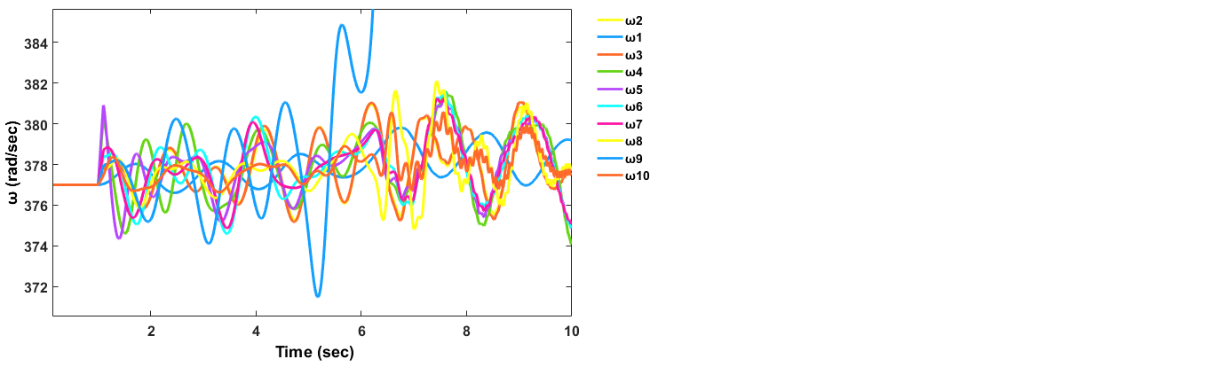
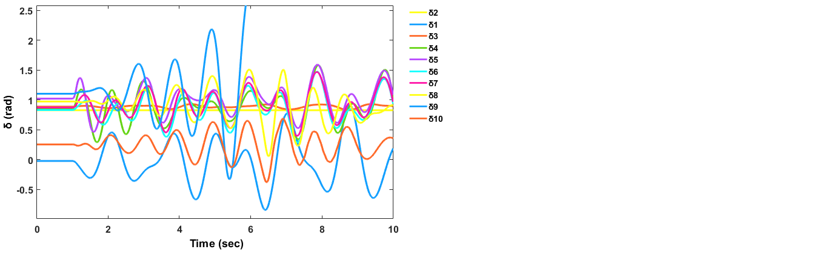
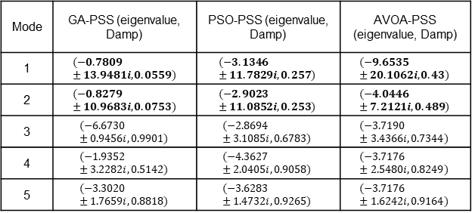
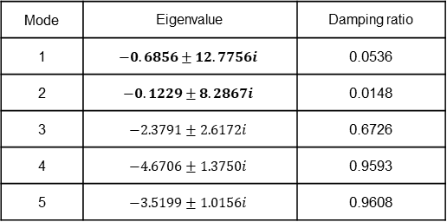
WSCC
State matrix eigenvalues and damping ratio
State matrix eigenvalues, and damping ratio of the algorithms in
PSS design
Mode | Eigenvalue | Damping ratio
1 | $$−0.6856±12.7756i$$ | 0.0536
2 | $$−0.1229±8.2867i$$ | 0.0148
3 | $$−2.3791±2.6172i$$ | 0.6726
4 | $$−4.6706±1.3750i$$ | 0.9593
5 | $$−3.5199±1.0156i$$ | 0.9608
Mode | GA-PSS (eigenvalue, Damp) | PSO-PSS (eigenvalue, Damp) | AVOA-PSS (eigenvalue, Damp)
1 | $$(−0.7809±13.9481i,0.0559)$$ | $$(−3.1346±11.7829i,0.257)$$ | $$(−9.6535±20.1062i,0.43)$$
2 | $$(−0.8279±10.9683i,0.0753)$$ | $$(−2.9023±11.0852i,0.253)$$ | $$(−4.0446±7.2121i,0.489)$$
3 | $$(−6.6730±0.9456i,0.9901)$$ | $$(−2.8694±3.1085i,0.6783)$$ | $$(−3.7190±3.4366i,0.7344)$$
4 | $$(−1.9352±3.2282i,0.5142)$$ | $$(−4.3627±2.0405i,0.9058)$$ | $$(−3.7176±2.5480i,0.8249)$$
5 | $$(−3.3020±1.7659i,0.8818)$$ | $$(−3.6283±1.4732i,0.9265)$$ | $$(−3.7176±1.6242i,0.9164)$$
New England
No PSS controller condition response of the rotor speed and angle deviation to fault on the power test system

Slide 15
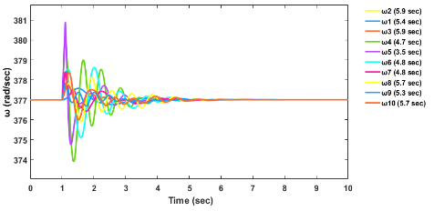
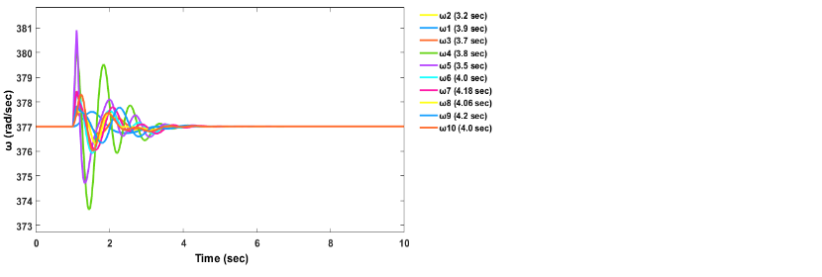
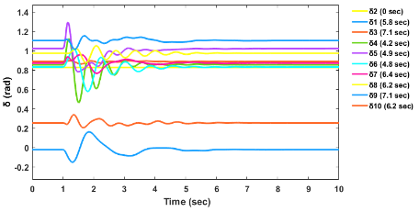
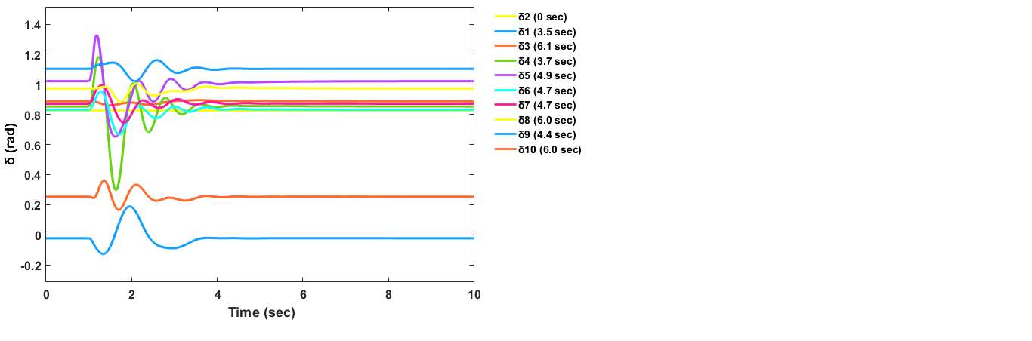
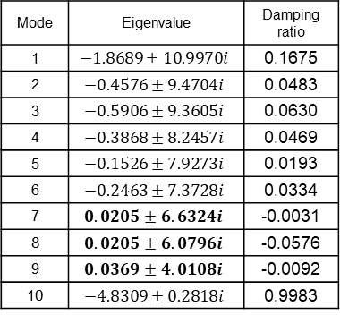
GA
PSO
State matrix eigenvalues and damping ratio
Mode | Eigenvalue | Damping ratio
1 | $$−1.8689±10.9970i$$ | 0.1675
2 | $$−0.4576±9.4704i$$ | 0.0483
3 | $$−0.5906±9.3605i$$ | 0.0630
4 | $$−0.3868±8.2457i$$ | 0.0469
5 | $$−0.1526±7.9273i$$ | 0.0193
6 | $$−0.2463±7.3728i$$ | 0.0334
7 | $$0.0205±6.6324i$$ | -0.0031
8 | $$0.0205±6.0796i$$ | -0.0576
9 | $$0.0369±4.0108i$$ | -0.0092
10 | $$−4.8309±0.2818i$$ | 0.9983
GA algorithm for PSS damping controller design response of rotor speed and angle deviation
The rotor speed and angle deviation response for the PSO algorithm in the PSS damping controller’s design

Slide 16
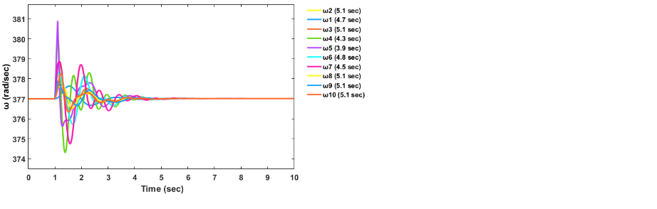
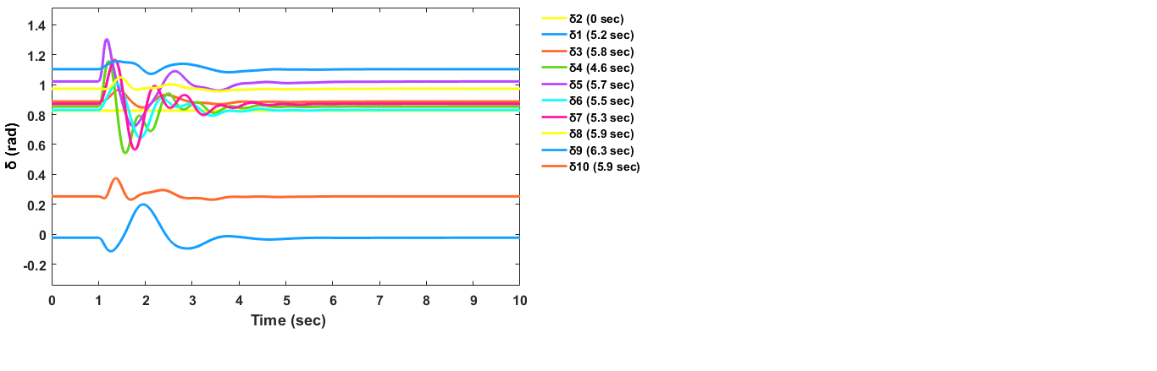
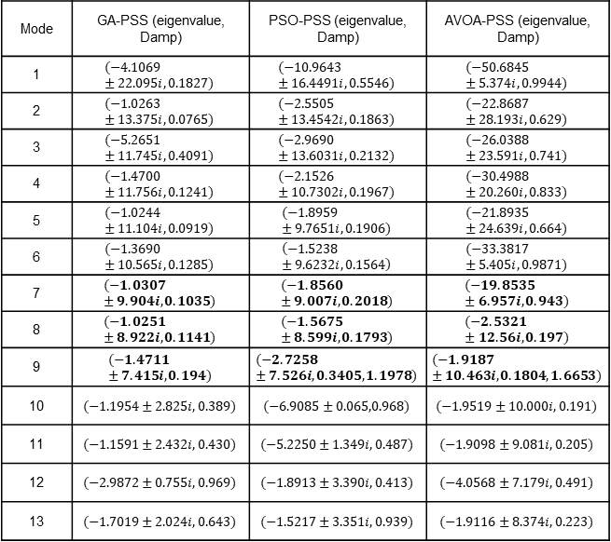
AVOA
State matrix frequency, damp, and eigenvalues of the algorithms in damping controller design
Mode | GA-PSS (eigenvalue, Damp) | PSO-PSS (eigenvalue, Damp) | AVOA-PSS (eigenvalue, Damp)
1 | $$(−4.1069±22.095i,0.1827)$$ | $$(−10.9643 ±16.4491i,0.5546)$$ | $$(−50.6845±5.374i,0.9944)$$
2 | $$(−1.0263±13.375i,0.0765)$$ | $$(−2.5505±13.4542i,0.1863)$$ | $$(−22.8687±28.193i,0.629)$$
3 | $$(−5.2651±11.745i,0.4091)$$ | $$(−2.9690±13.6031i,0.2132)$$ | $$(−26.0388±23.591i,0.741)$$
4 | $$(−1.4700±11.756i,0.1241)$$ | $$(−2.1526±10.7302i,0.1967)$$ | $$(−30.4988±20.260i,0.833)$$
5 | $$(−1.0244±11.104i,0.0919)$$ | $$(−1.8959±9.7651i,0.1906)$$ | $$(−21.8935±24.639i,0.664)$$
6 | $$(−1.3690±10.565i,0.1285)$$ | $$\left(−1.5238±9.6232i,0.1564\right)$$ | $$(−33.3817±5.405i,0.9871)$$
7 | $$(−1.0307±9.904i,0.1035)$$ | $$(−1.8560±9.007i,0.2018)$$ | $$(−19.8535±6.957i,0.943)$$
8 | $$(−1.0251±8.922i,0.1141)$$ | $$(−1.5675±8.599i,0.1793)$$ | $$(−2.5321±12.56i,0.197)$$
9 | $$(−1.4711±7.415i,0.194)$$ | $$(−2.7258±7.526i,0.3405,1.1978)$$ | $$(−1.9187±10.463i,0.1804,1.6653)$$
10 | $$(−1.1954±2.825i,0.389)$$ | $$(−6.9085±0.065,0.968)$$ | $$(−1.9519±10.000i,0.191)$$
11 | $$(−1.1591±2.432i,0.430)$$ | $$(−5.2250±1.349i,0.487)$$ | $$(−1.9098±9.081i,0.205)$$
12 | $$(−2.9872±0.755i,0.969)$$ | $$(−1.8913±3.390i,0.413)$$ | $$(−4.0568±7.179i,0.491)$$
13 | $$(−1.7019±2.024i,0.643)$$ | $$(−1.5217±3.351i,0.939)$$ | $$(−1.9116±8.374i,0.223)$$
The rotor speed and angle deviation response for the AVOA algorithm in the PSS damping controller’s design

Slide 17
Contribution to knowledge
This present study adopts AVOA for PSS damping controller design in three IEEE benchmark test systems (SMIB, WSCC and New England). Further comparison was done with Particle swarm optimized and Genetic algorithm optimized PSS damping controllers which according to [13], are the most widely utilized metaheuristic algorithms in PSS damping controller design.

Slide 18
Conclusion
Electromechanical oscillation control which threatens the stability of the power grid system if poorly controlled has been presented in this study. AVOA-PSS damping controller was used to damp this oscillation and return the three selected electrical power grid test systems to stable operation after being subjected to a three-phase symmetrical fault. For optimal performance of the PSS damping controllers.

Slide 19
Recommendations
This study can be further improved with the introduction of Fuzzy and Neural network damping controllers.
Machine learning can be applied in optimizing the adopted damping controller design.

Slide 20
References
[1] S. Ekinci, D. İzci, and B. Hekimoğlu, “Implementing the Henry gas solubility optimization algorithm for optimal power system stabilizer design,” Electrica, vol. 21, no. 2, pp. 250–258, 2021.
[2] S. Ekinci, A. Demiroren, and B. Hekimoglu, “Parameter optimization of power system stabilizers via the kidney-inspired algorithm,” Trans. Inst. Meas. Control, vol. 41, no. 5, pp. 1405–1417, 2019.
[3] H. Beiranvand and E. Rokrok, “General relativity search algorithm: a global optimization approach,” Int. J. Comput. Intell. Appl., vol. 14, no. 03, p. 1550017, 2015.
[4] M. A. El-Dabah, S. Kamel, M. Khamies, H. Shahinzadeh, and G. B. Gharehpetian, “Artificial Gorilla Troops Optimizer for Optimum Tuning of TID Based Power System Stabilizer,” In 2022 9th Iranian Joint Congress on Fuzzy and Intelligent Systems (CFIS), 2022, pp. 1–5.
[5] D. Chitara, K. R. Niazi, A. Swarnkar, and N. Gupta, “Cuckoo search optimization algorithm for designing of a multimachine power system stabilizer,” IEEE Trans. Ind. Appl., vol. 54, no. 4, pp. 3056–3065, 2018.

